Slide 1
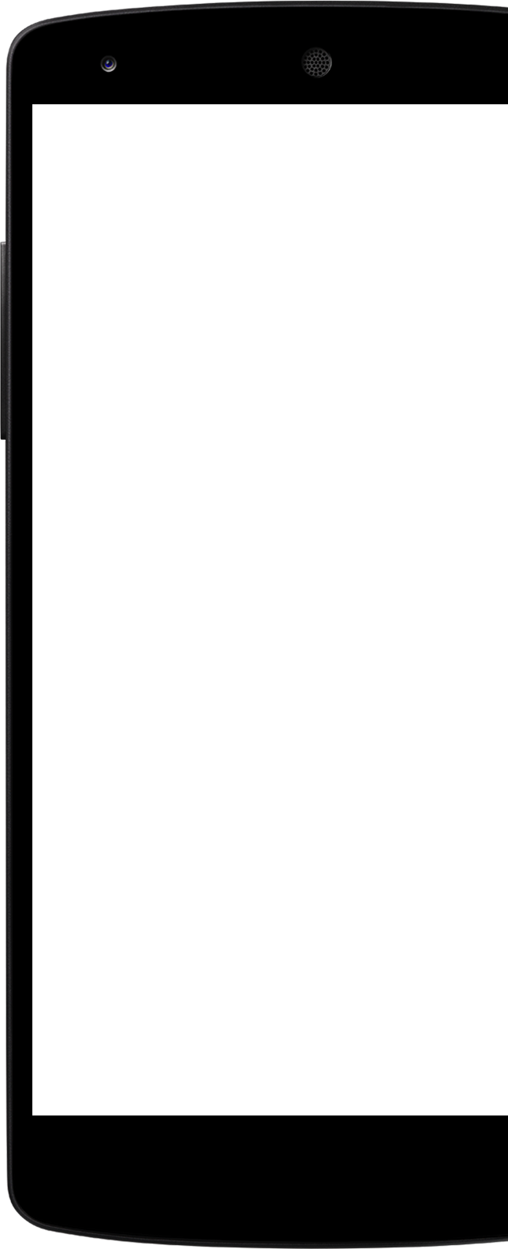

Design of An Automated Drink Dispensing System
By: Nathan Bane, Chris Blanks, and Ryan Valente
Notes:
Chris

Slide 2
Outline
Background/Motivation
Design Requirements and Constraints
Planning & Design
Implementation Plan
Implementation
Questions?

Slide 3
Background/Motivation

Slide 4
Introduction
Long wait times are a detriment for any industry, especially the bar industry. By using automation and robotics to reduce wait time for the customer, larger profits and increased customer satisfaction can be achieved.
Notes:
Chris

Slide 5
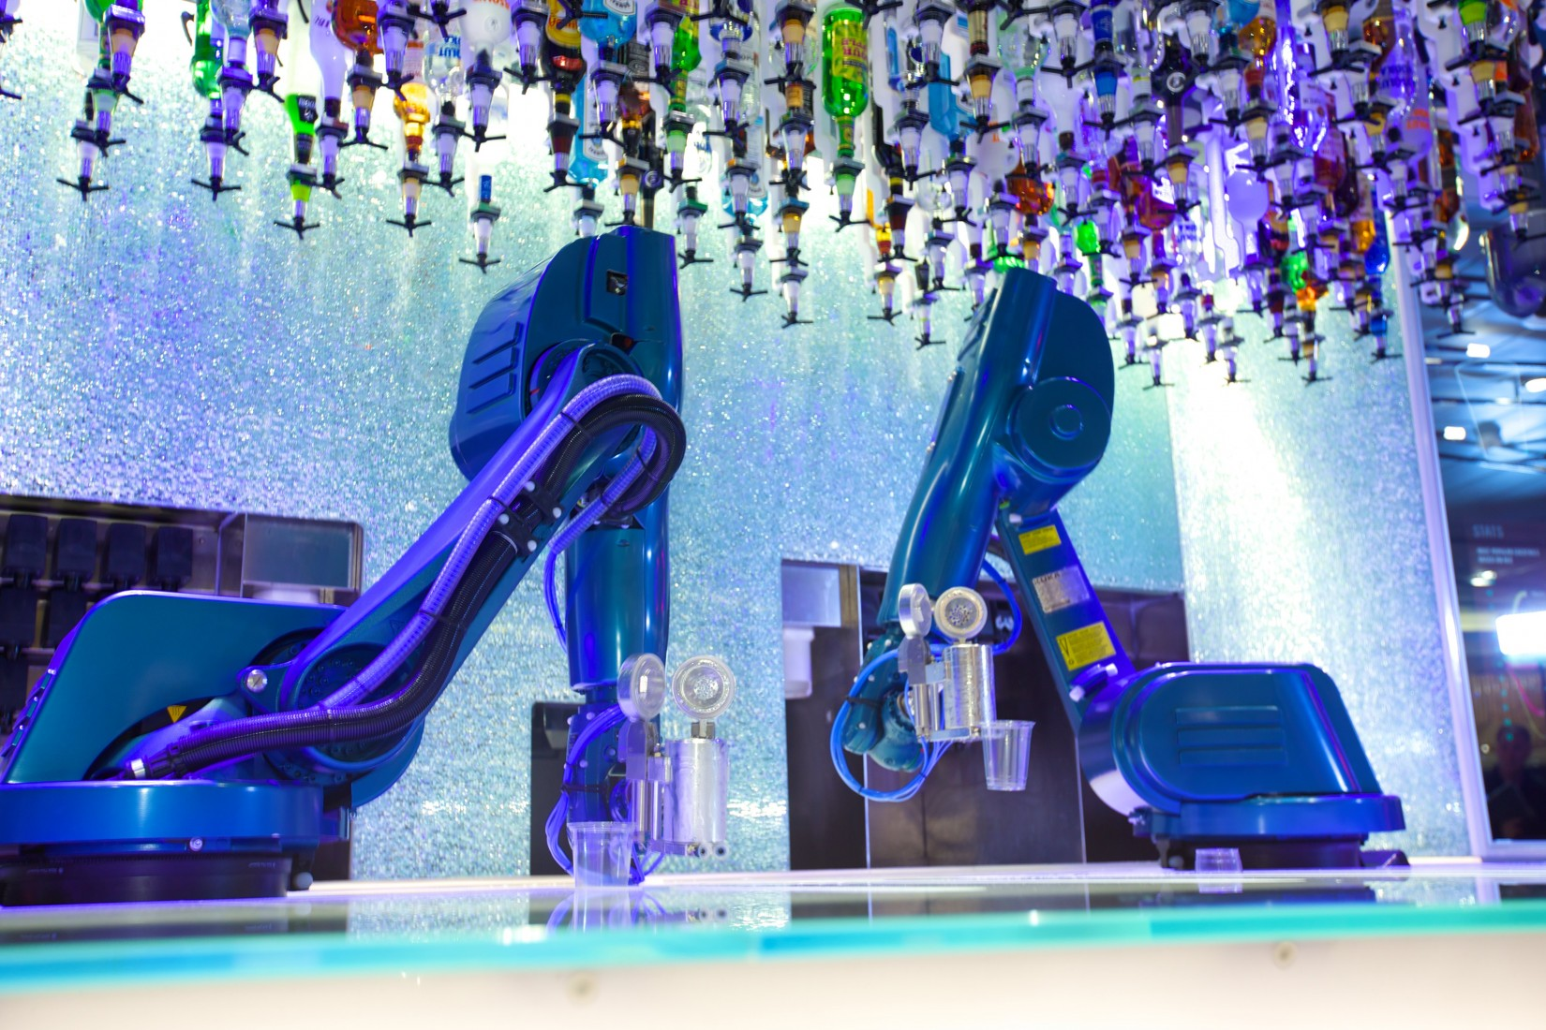
Market solution #1
Royal Caribbean Bar Tending Robot
Robotic arm based design
Suspended drinks with special spouts
Makes drinks that are stirred, shook, and muddle
Two drinks per minute
30 spirits and 21 mixers
Notes:
Chris

Slide 6
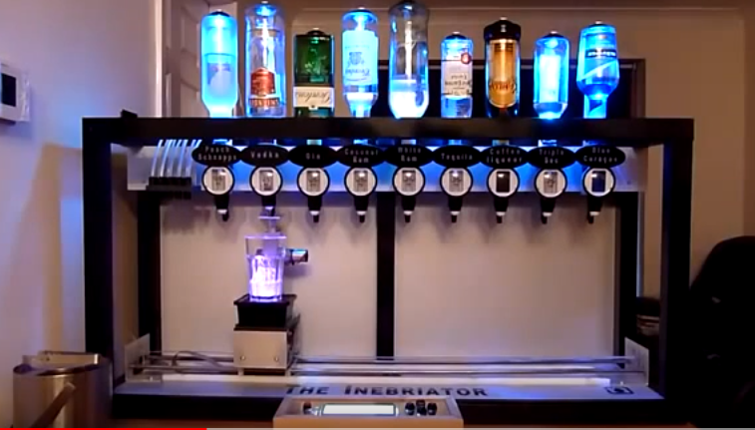
Market solution #2
Random Youtube Drink Making Robot
Linear translation to dispense drinks into cup
Beaumont Spirit Measure device
1 drink at a time
9 drinks available and suspended
Notes:
Chris

Slide 7
Objective
Design an automated drink dispensing system that will offer a more economical solution to reduce wait time for drinks and reduce human error in the drink making process.
Notes:
Nathan

Slide 8
Design Requirements and Constraints
Notes:
Nathan

Slide 9
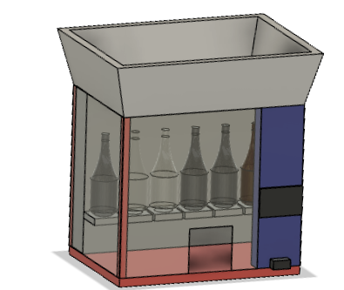
Design Requirements
General Specifications:
Dimensions: 3’ x 2’ x 3’ (lwh)
Dry Weight: 50 lbs
Power Requirements: 120V
Capacity: Bottles for 12 Liquids
Embedded System Specifications:
Two System Configurations
Broadcast shared data within minute intervals
Notes:
Nathan

Slide 10

Design Requirements (continued)
Features
Touchscreen User Interface
Main Computer
Embedded Board
Dual Mode for Desktop Application
Security
Remote Monitoring
Notes:
Chris

Slide 11
Design Constraints
Has to be on a raised platform
Food Safety
Notes:
Chris

Slide 12
Planning & Design
Notes:
Nathan

Slide 13
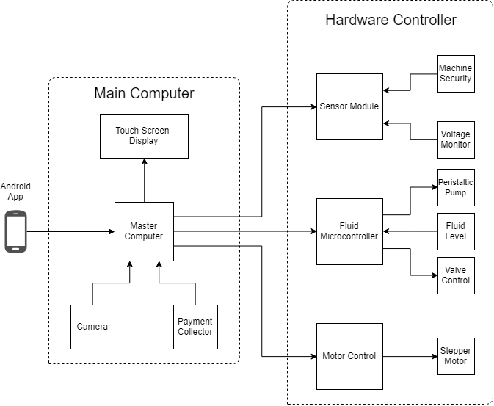
System Description
Notes:
Nathan

Slide 14
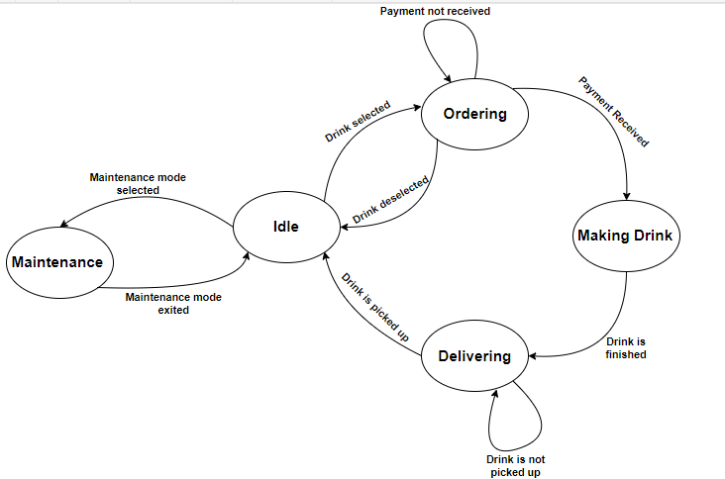
System States
Notes:
Chris

Slide 15
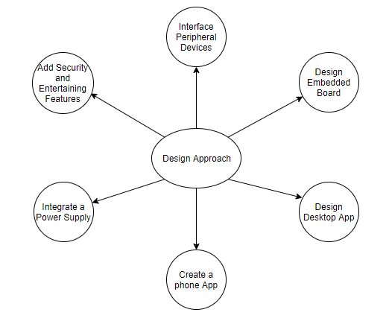
Design Approach

Slide 16
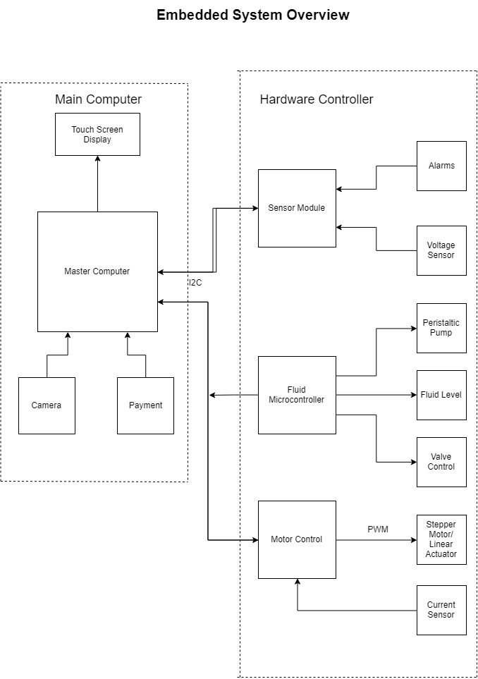
System Description: Embedded Electronics
Hardware Controller
The fluid microcontroller will be used to control the fluid flow
Control and interface valves
Stepper motor driver to control peristaltic pumps
Motor controller to drive the motor used to dispense ice
Sensor module will gather all data necessary to basic operation of the vending machine
Main Computer
Will be connected to the touch screen
Will send commands to the motor controller and fluid microcontroller through the use of I2C
Has to keep a collection of information in the local file system, which will pertain to current inventory and system information
Will use the camera for checking a customer’s license
Will host a http server to share relevant data
Notes:
Nathan

Slide 17
Implementation Plan
Notes:
Nathan

Slide 18
Tasks
Design a Fluid Control Hardware PCB
1.1 Design a High-Side Switch:
1.2 Design a Motor Driver:
1.3 Design a I2C GPIO Expander and Supporting Circuitry
1.4 Design a I2C Thermometer and Supporting Circuitry
1.5 Design a I2C Input Power Current Sensor
1.6 Design a Printed Circuit Board.
1.7 Create a Bill of Materials, Order Components and Printed Circuit Board
1.8 Assemble Components onto Printed Circuit Board.
1.9 Develop code for the printed circuit board to test assembly.

Slide 19
Tasks (continued)
2. Design Fluid Microcontroller Printed Circuit Board
2.1 Select Microcontroller and develop supporting circuitry for microcontroller
2.3 Interface switches with microcontroller to manipulate modes of microcontroller
2.4 Layout Printed Circuit Board
2.5 Assemble Components onto Printed Circuit Board
2.6 Code Microcontroller to receive commands through I2C from the master computer
3. Develop a communication scheme between the main computer, and the embedded development board
Notes:
Nathan

Slide 20
Tasks (continued)
Create desktop application for the main computer
Design a GUI using Python’s Tkinter Library that the customers will use
Develop an efficient way to organize system and drink information in the file storage system
Add in capabilities for communication between the main computer and peripheral devices
Write code to interface the main computer with the embedded boards and peripherals
Create an Android phone application
Design the user interface of the phone app with Android Studio’s SDK
Allow the phone app to access the system information stored on the main computer and acquire relevant data for use within the app
Provide monitoring features (e.g. current stock left, low level of inventory, total sales)
Create extra capabilities and entertaining features
Incorporate facial recognition into the desktop application.
Adapt desktop application for compatibility with the Python Package index
Notes:
Chris

Slide 21
Team Organization
Time | Task | Comments | Responsible Personnel
Fall 2018 Semester
Week 1-5 | N/A | Project proposal and planning | Nathan Bane
Week 5- Week 7 | Task 1 (subtask 1.1,1.2) | Design and draw up a schematic for a high-side switch. Develop circuitry to control a brushed DC Motor .
Week 8- Week 10 | Task 1(subtask 1.3-1.5) | Design and layout circuitry to support an I2C Thermometer, Current Sense Circuitry, and I2C Gpio Expander
Week 11- Week 13 | Task 1(subtask 1.6-1.7) | Layout the components on the Printed Circuit Board and order Printed Circuit Board with parts
Week 13 - End of Semester | Task 1(subtask 1.8-1.9) | Solder components onto the printed circuit board and develop code to test the printed circuit board
Spring 2019 Semester
Week 1-4 | Task 2(subtask 2.1-2.4) | Choose a suitable microcontroller and develop supporting circuitry. | Nathan Bane
Week 5- Week 8 | Task 2(subtask 2.5-2.6) | Layout printed circuit board, order components , and assemble components onto printed circuit board | Nathan Bane
Week 9 -End of the semester | Task 2(subtask 2.4 ), Task 3 | Develop Code for Embedded. Develop communication scheme between master computer and fluid microcontroller | Nathan Bane & Christopher Blanks
Notes:
Nathan

Slide 22
Team Organization
Time | Task | Comments | Responsible Personnel
Fall 2018 Semester
Week 1- Week 9 | Task 4 (subtask 4.1, 4.2, 4.3) | Design and create the main application. Test the inputs and outputs of the system, so that it will interface correctly with the embedded boards and other peripherals. | Chris Blanks
Week 10- Week 15 | Task 5 (subtask 5.1, 5.2, 5.3) | Design and create the phone application.
Spring 2019 Semester
Week 1-2 | Task 6 (subtask 6.2) | Restructure desktop application software for compliance and compatibility with the Python Package Index
Week 3-End of the semester | Task 4(subtask 4.4 ), Task 6 (subtask 6.1) | Finish interfacing and testing the main computer/application with the other systems. Incorporate facial recognition into the main application. Documentation.
Notes:
Chris

Slide 23
Implementation

Slide 24
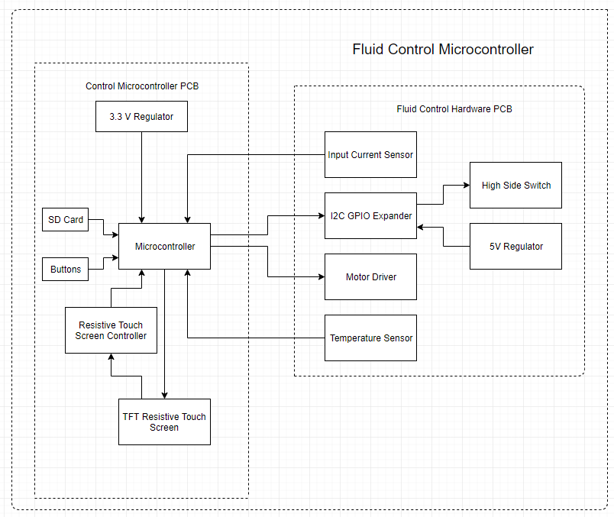
Task 1 - Fluid Microcontroller System Diagram
Control Microcontroller PCB
Separates the microcontroller from the heat generated by the fluid control hardware PCB and helps to isolates ground planes from current loops
Fluid Control Hardware PCB
Interfaces with the valves and pumps
Notes:
Nathan

Slide 25
Our Drink Menu For This Prototype
Drink Menu
Naval Gimlet
Long Island Iced Tea
Rum & Coke
Daiquiri
Kamikaze
Cuba Libre
Vodka
Tequila
Screwdriver
Vodka & Cranberry
Inventory to make drinks on menu
Liquors
Gin
Vodka
Light Rum
Tequila
Liqueur
Triple Sec
Mixers
Soda water, Coke
Simple Syrup
Lemon juice, lime juice, orange juice, cranberry juice

Slide 26
Task 1 - Fluid Control Hardware
The Fluid Control Hardware will be the interfacing hardware between the microcontroller and the motors and valves.
Input Voltage: 12 - 24V
Max Current Draw: 12V - 17 A | 24V - 8.5 A
Digital Input Logic Voltage: 3.3 V

Slide 27
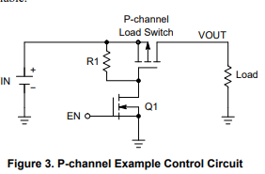
Task 1.1 - High Side Switch
A high-side switch allows devices to be disconnected from its power source.
Device: Solenoid Valve - 12-24V, 5-6 W
High-side switch requirements
Max Current: .5 A * 2 = 1 A
Max Voltage: 24 V
Logic Level (3.3 V) Control
A PMOS pass transistor was chosen over an NMOS transistor because it is simpler to switch due to the NMOS requiring its gate voltage to be greater than the NMOS threshold voltage plus its input voltage.

Slide 28
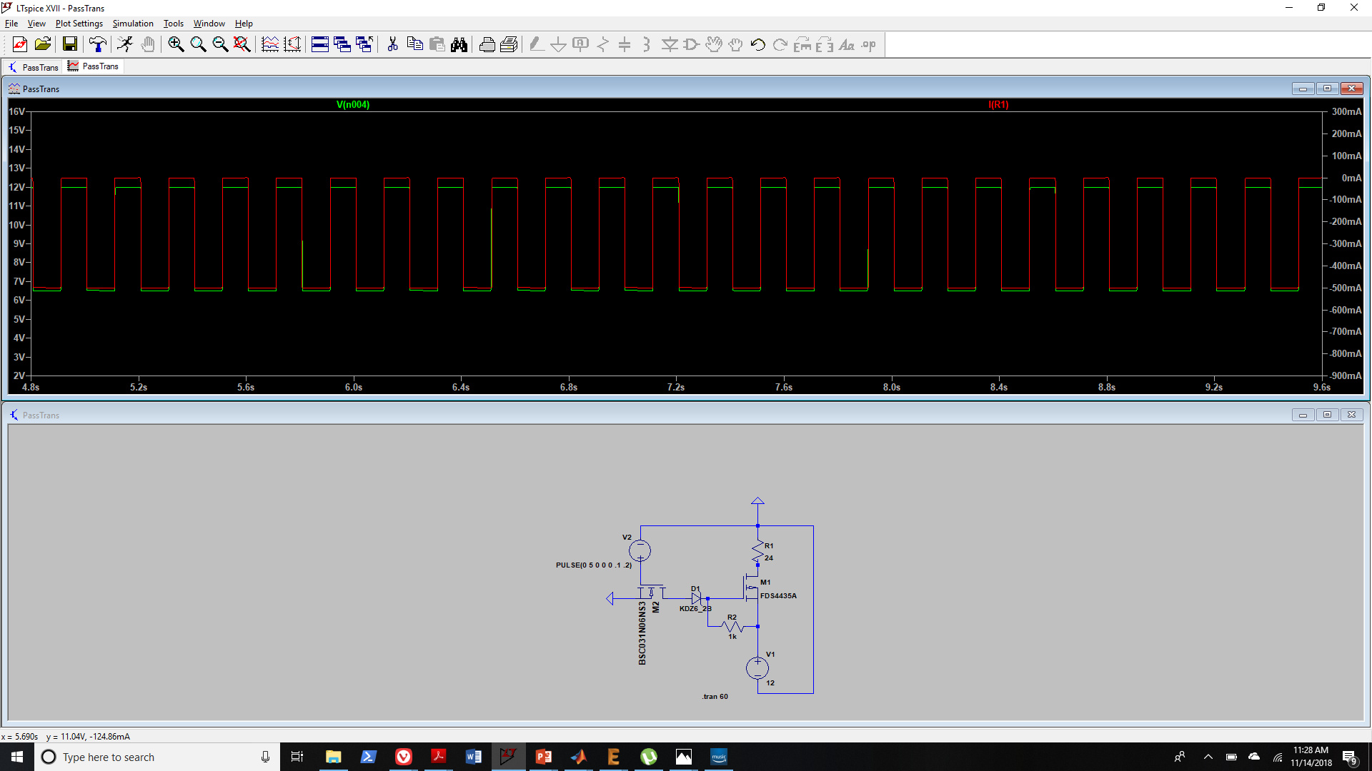
Task 1.1 High Side Switch Simulation

Slide 29
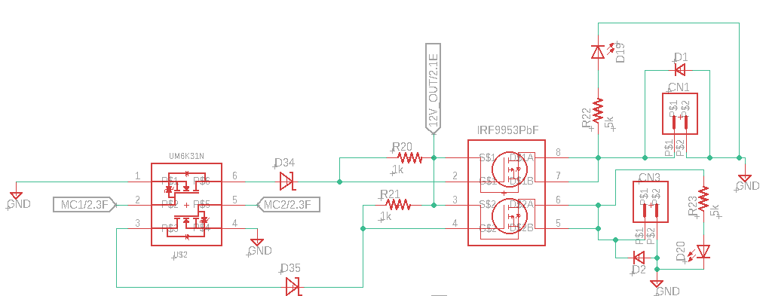
Task 1.1 - High Side Switch Layout
IRF9953PbF - PMOS Power Mosfet
Dual PMOS Package
Vds: -30 V
Vgs: +- 20V
Id: -1.8 A
Rds: .25 Ohm
UM6K31N - NMOS Logic Level Transistor
Dual NMOS Package
Rds: 2.4 Ohm @ 3.3 V VGS

Slide 30
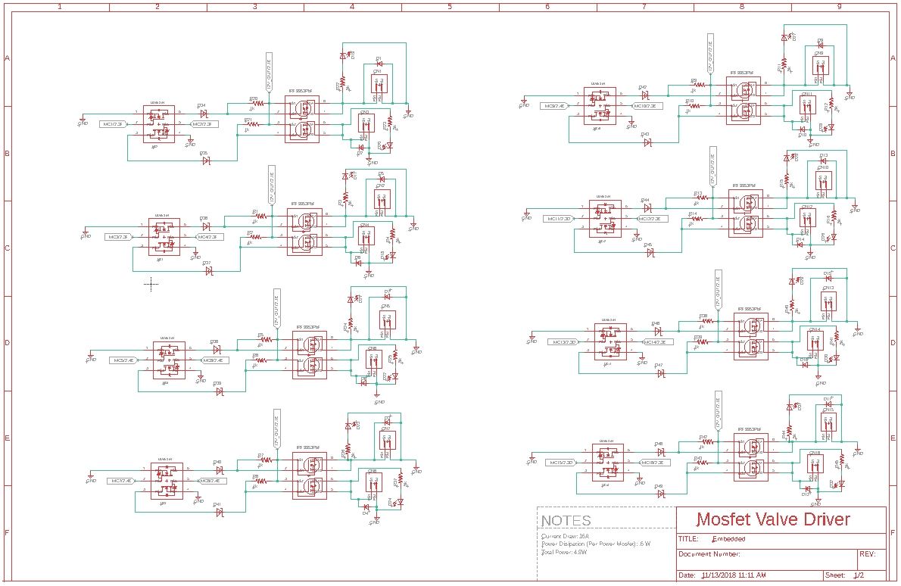
Task 1.1 High Side Switch Full Layout

Slide 31
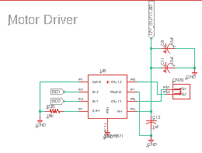
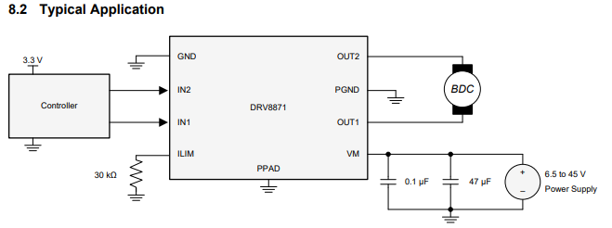
Task 1.2 - Motor Driver
Fig 1: Schematic
Power Requirements for Peristaltic Pump:
Voltage: 12V
Current: 2.5A
Texas Instruments DRV8871
Voltage: 6.5-45V
Current: 3.6 A
Control: PWM
Integrated Protection Features:
Overcurrent Protection
Thermal Shutdown
Fig 2: Data Sheet Configuration

Slide 32
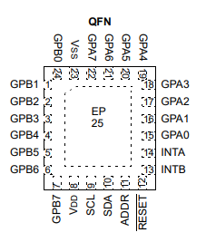
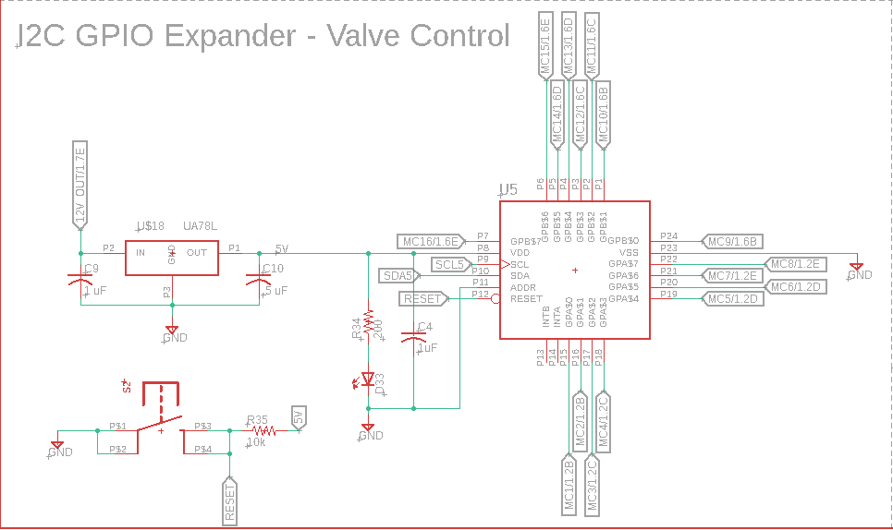
Task 1.3 - I2C GPIO Expander
The purpose of the I2C GPIO Expander is to limit the number of pins needed on the microcontroller to control the valves:
MCP23018:
5.5V 25mA (per pin)/ 400mA Total
I2C Interface Frequencies:
100 kHz
400 kHz
3.4 MHz
16 Pins
Open Drain

Slide 33
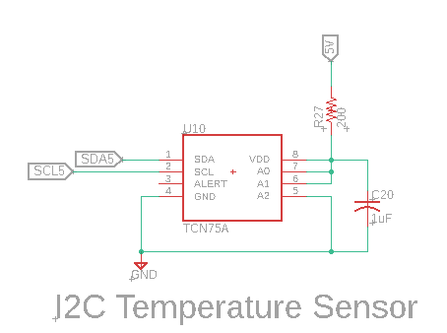
Task 1.4 - I2C Thermometer
The purpose of the I2C GPIO Thermometer is to monitor the overall temperature of the board to determine status of motor drivers
TCN75A:
Temperature Range: -40C - 125C
Accuracy: 0.0625C to .5C
I2C Interface Frequencies:
100 kHz
400 kHz

Slide 34
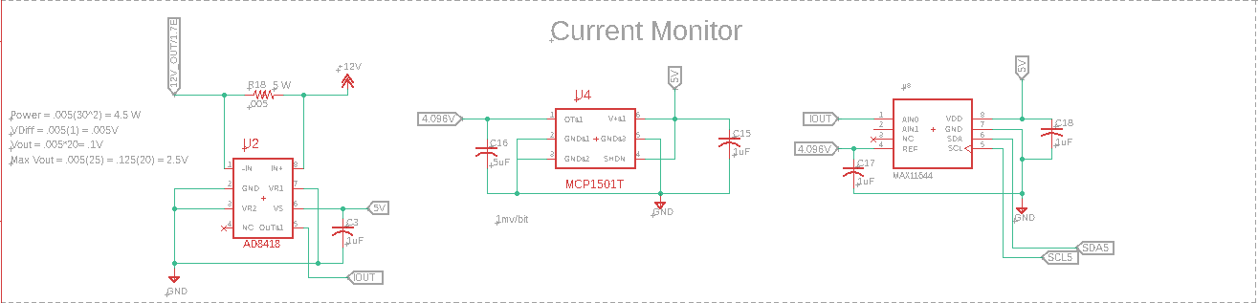
Task 1.5 - Input Current Sensor
It is important to be able to monitor the current draw of the board to determine the function of all components on the board.
Specifications:
Current Range: 50 mA - 25 A
Resolution: 10 mA/mV

Slide 35
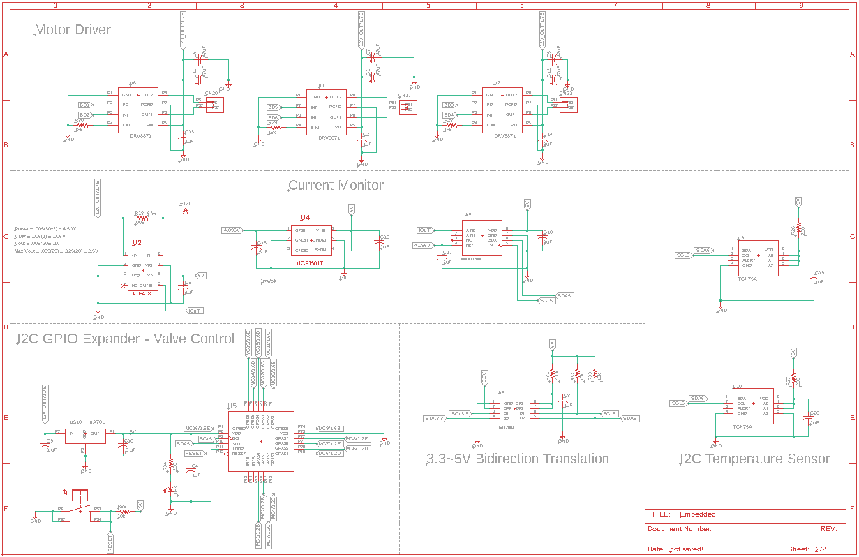
Current Status of Schematic

Slide 36
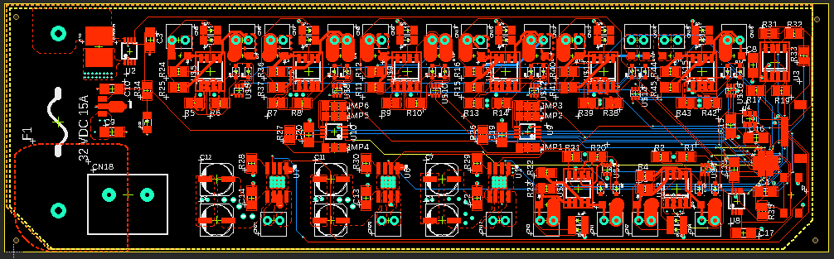
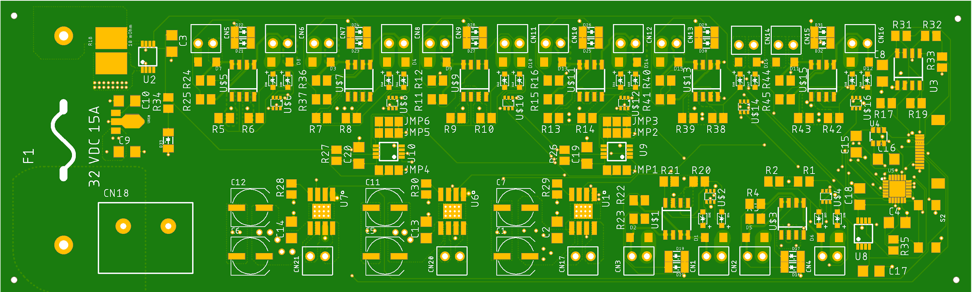
Task 1.6 - Layout Printed Circuit Board
Design Rules
4 - Layer Board
Signal 1
Power
GND
Signal 2
Large Copper Pours to Handle Current

Slide 37
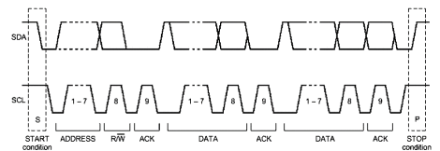
Task 1.9 - Develop Test Code I2C
What is I2C
I2C Communication Protocol consists of two wires the Serial Data Line (SDA) and Serial Clock (SCL) which are held logic high.
Each I2C device on the PCB has its own unique address - Address: 0X40 H
Generating Code consists of reading the datasheet to communicate with each register to manipulate the device.
MCP23018 - Important Registers
IODIRA - Input/Output Direction Register - Bank A - Address: 0x00 H
GPPUA - GPIO Pull-Up Resistor Register - Bank A - Address: 0x0C H
GPIOA - General Purpose I/O Port Register - Bank A - Address: 0x12 H

Slide 38
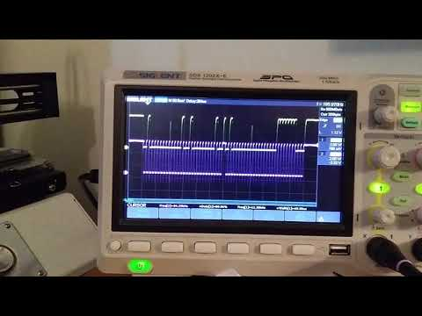
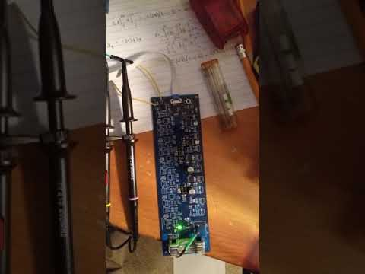
Task 1.9 - Develop Test Code I2C
I2C Signal
MCP23018 - GPIO Expander

Slide 39
Task 2.1 - Select Microcontroller
STM32 L476RCT6
32-Bit ARM Cortex-M4 80 MHz Microcontroller by STMicroelectronics
Why ARM - STM32?
I would like to learn ARM programming
STM32 has an extensive tool support for the microcontrollers
STM32CubeMX - Graphical User Interface for setting up pins on a microcontroller by generating code that can be used.
STM32HAL - A hardware abstraction layer that makes the STM32 as easy to program as an Arduino.
The test code utilized a STM32L432 - Nucleo-32 Development Board
51 I/0 Pins - 3 I2C Channels - 256 KB Program Memory - 1.71 V ~ 3.6 V

Slide 40
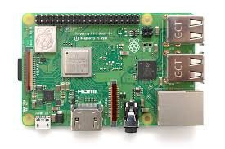
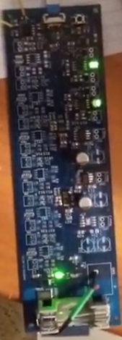
Task 3: Develop a communication scheme between the main computer and embedded boards
Creating a custom communication scheme between the main computer and embedded boards
Transmitting multiple bytes of data for commands and responses
Start drink making process
Halt drink making process
Send inventory information
Hardware pins for signaling when to communicate

Slide 41


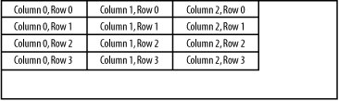
Task 4, Subtask 4.1: Design a GUI using Tkinter
Design Strategies:
Model-View-Controller OOP Pattern
C.R.U.D
Grid Geometry Manager
AES Symmetric key encryption

Slide 42
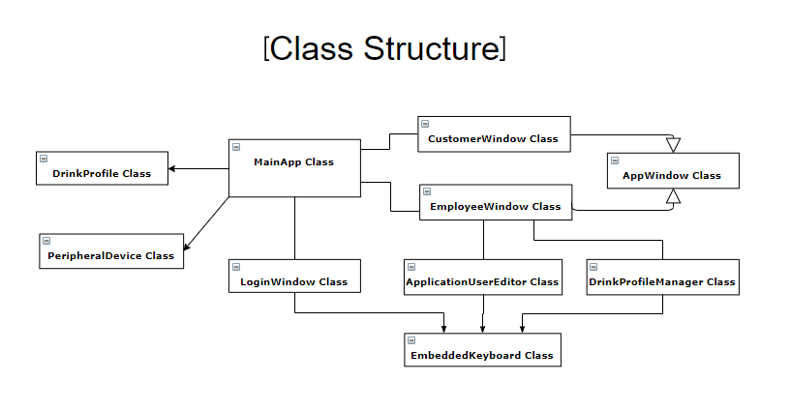
Task 4, Subtask 4.1: Design a GUI using Tkinter

Slide 43
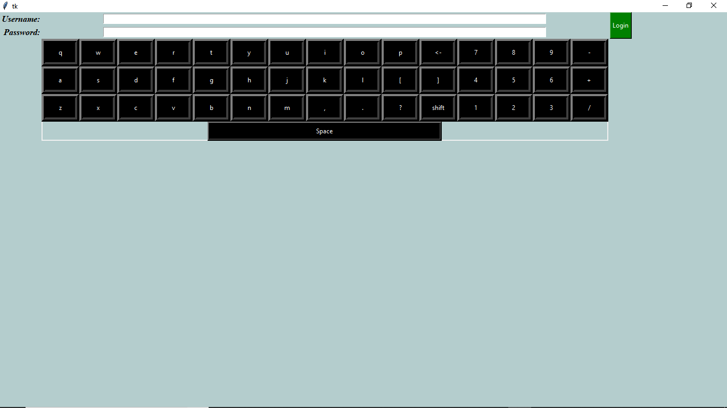
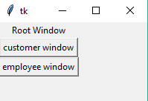
Task 4, Subtask 4.1: Design a GUI using Tkinter
Root Window
Login Window with Embedded Keyboard

Slide 44
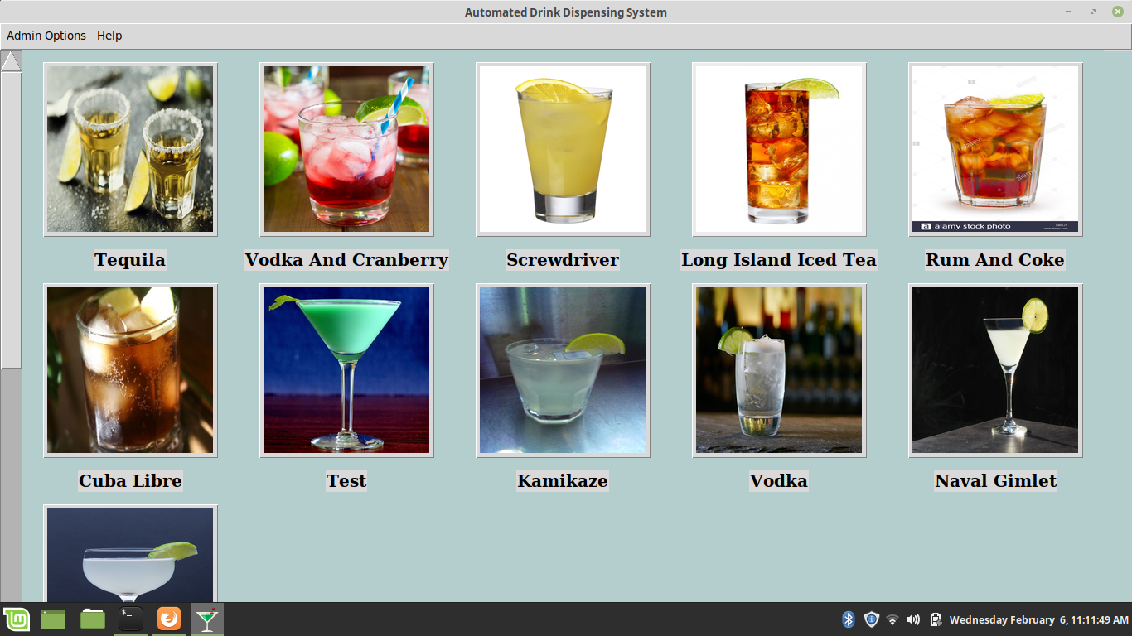
Task 4, Subtask 4.1: Design a GUI using Tkinter
Main Employee Window

Slide 45
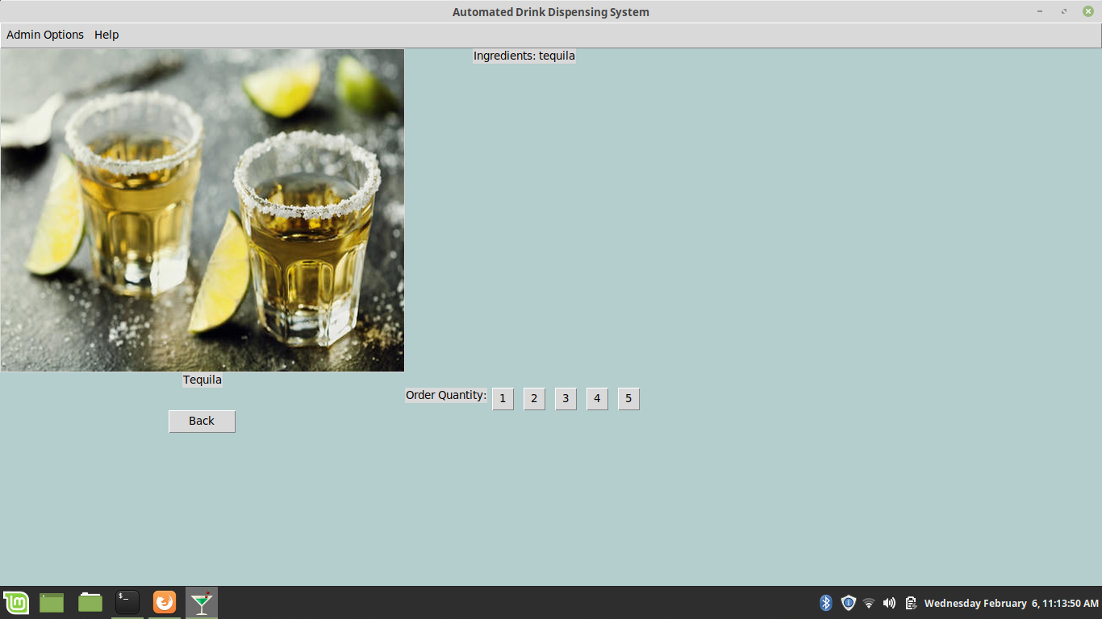
Task 4, Subtask 4.1: Design a GUI using Tkinter
Drink Profile In Employee Window

Slide 46
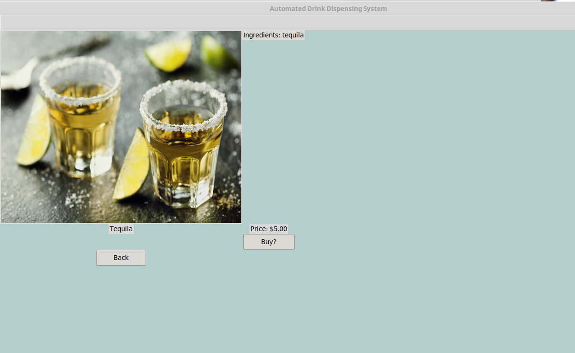
Task 4, Subtask 4.1: Design a GUI using Tkinter
Drink Profile in Customer Window

Slide 47
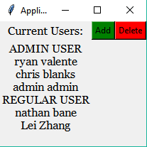
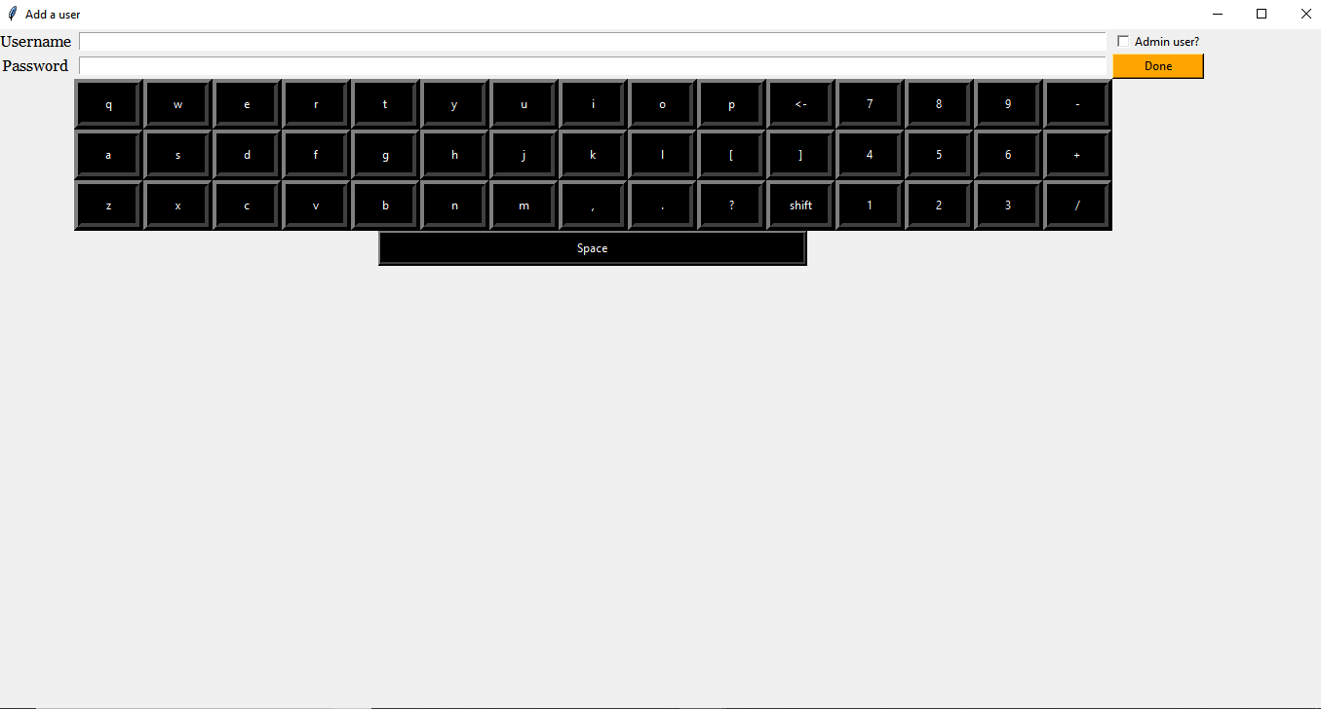
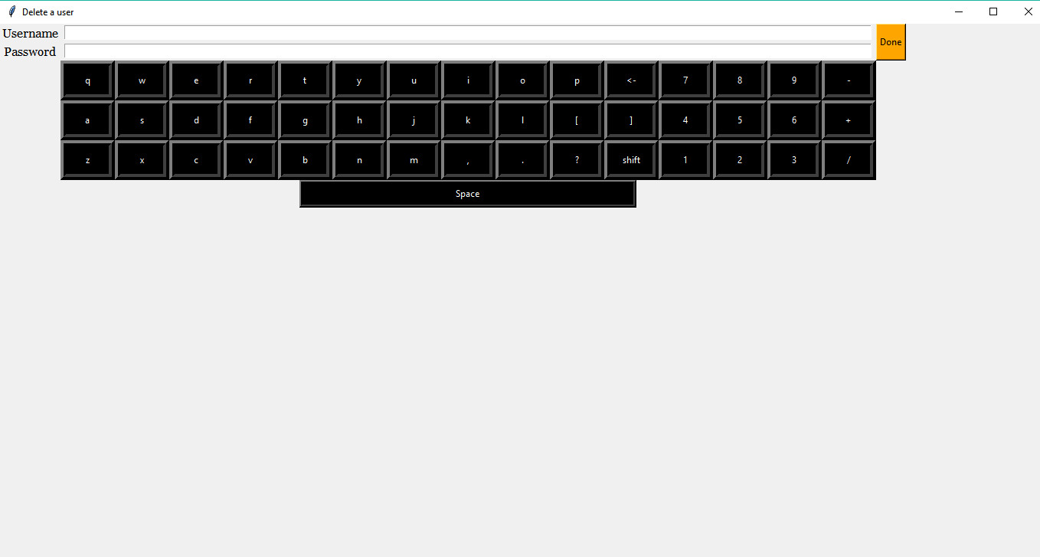
Task 4, Subtask 4.1: Design a GUI using Tkinter
Add a user
Add a user Window
Delete A User Window

Slide 48
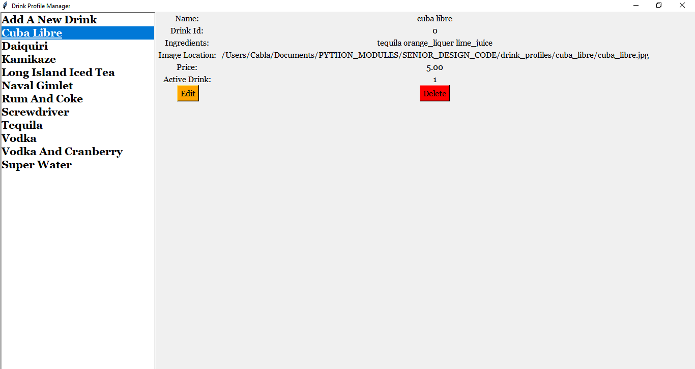
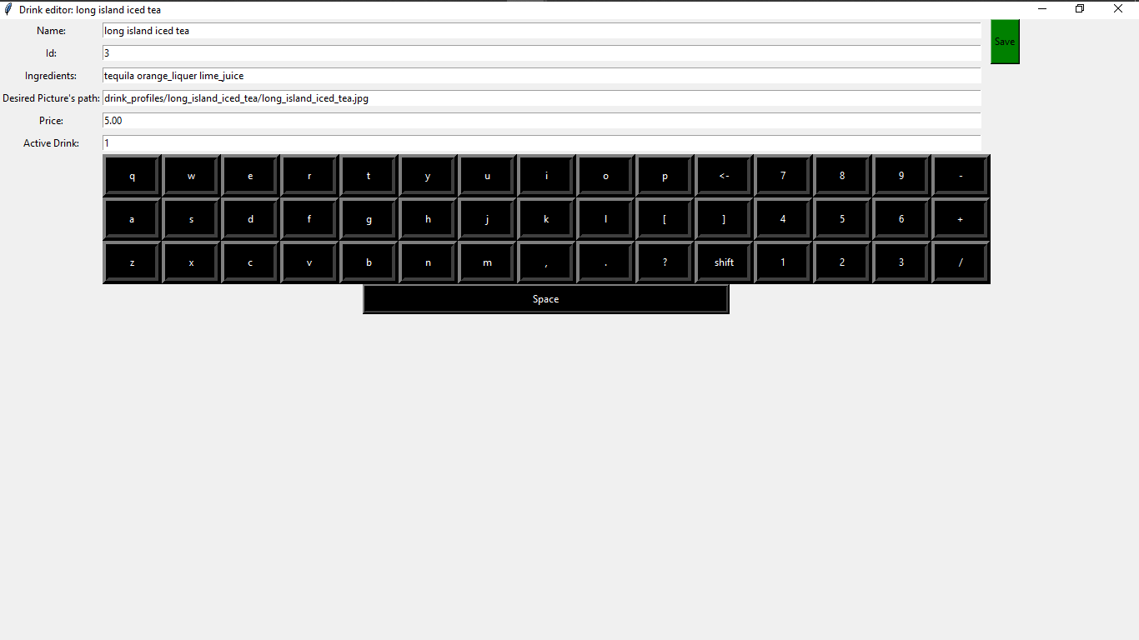
Task 4, Subtask 4.1: Design a GUI using Tkinter
Drink Profile Manager
Drink Editor

Slide 49
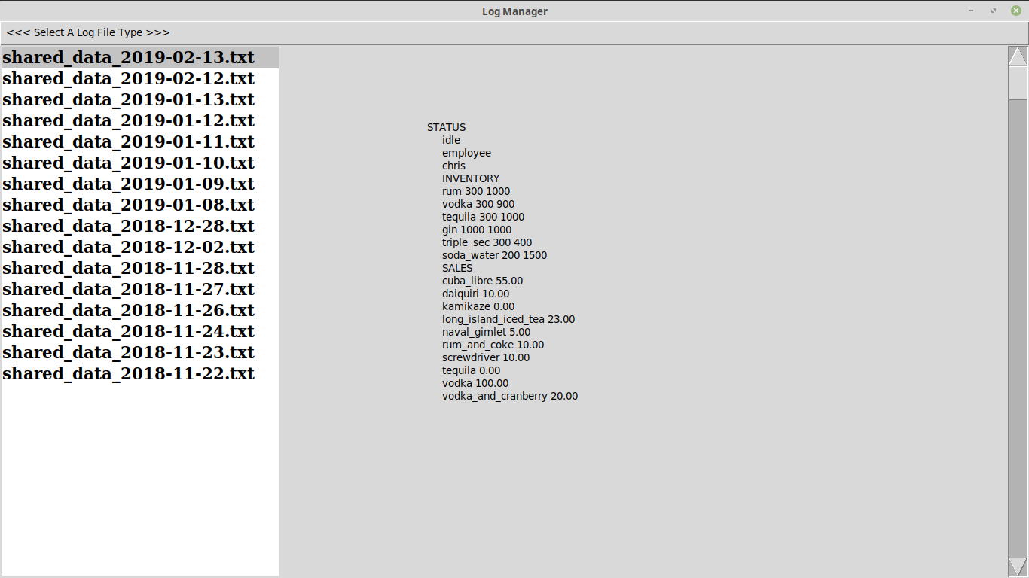
Task 4, Subtask 4.1: Design a GUI using Tkinter
Log File Manager

Slide 50
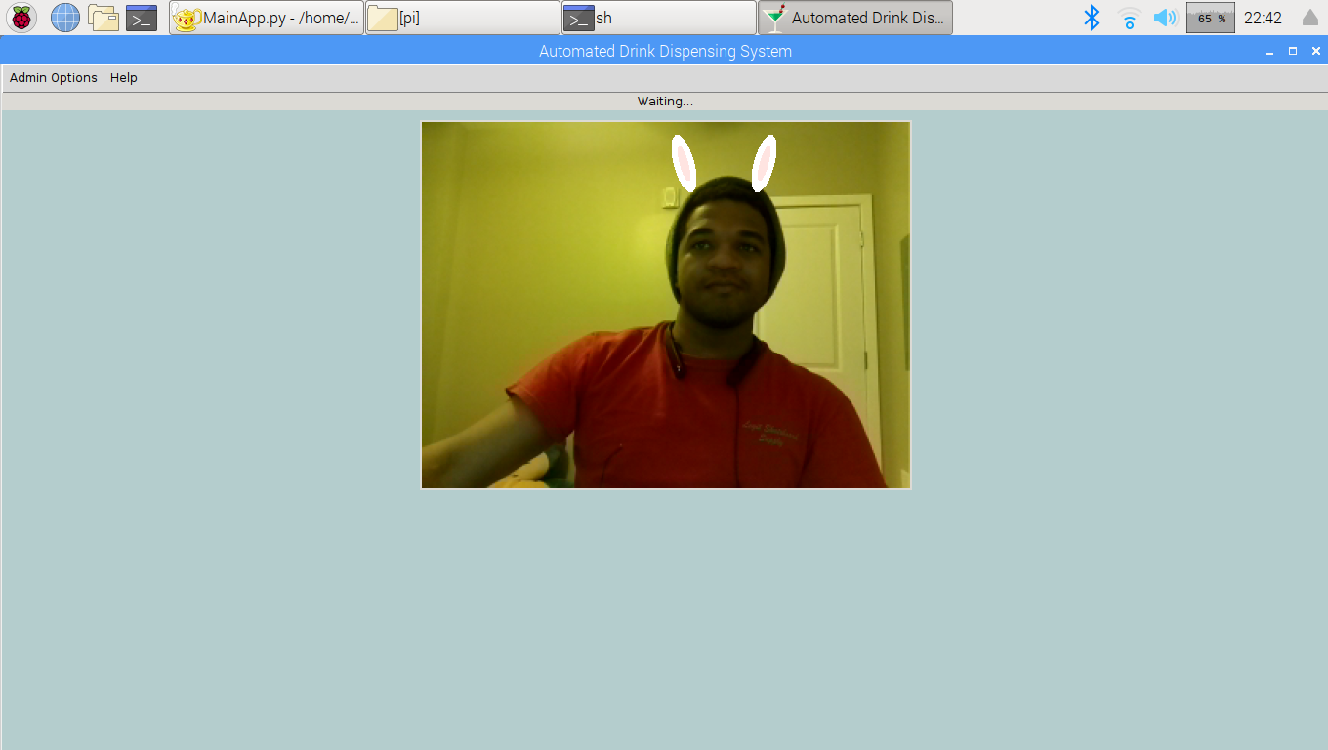
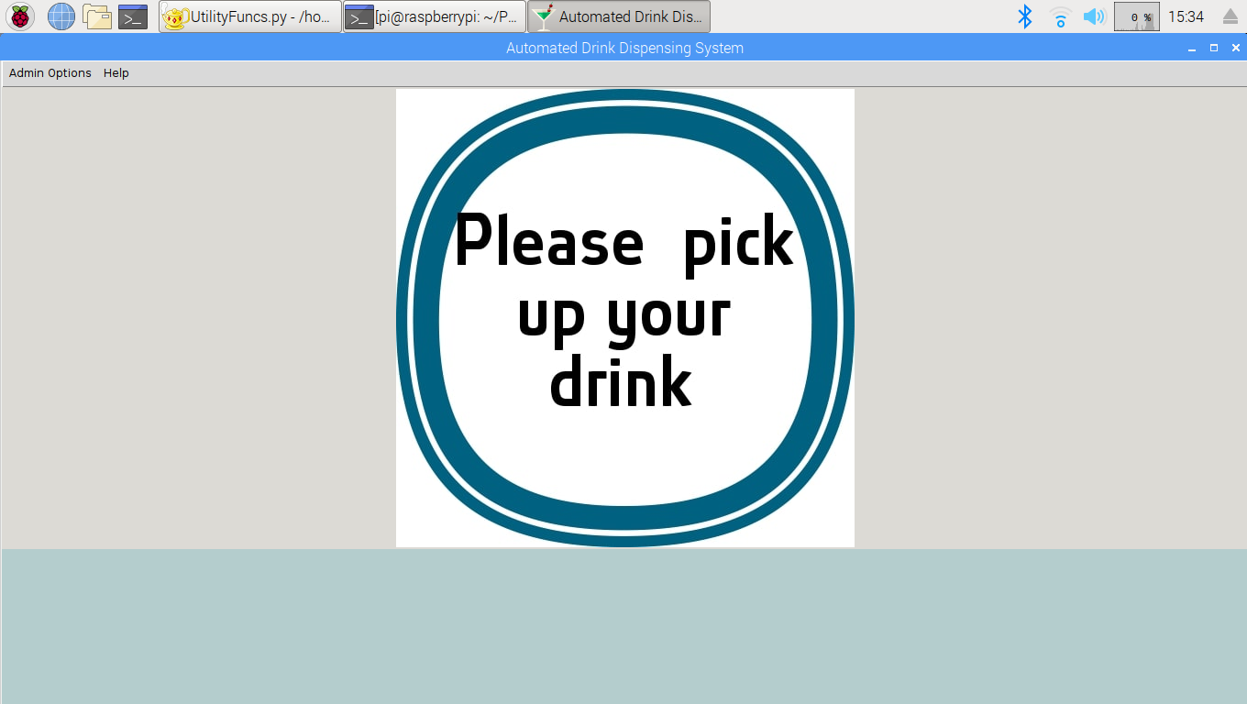
Task 4, Subtask 4.1: Design a GUI using Tkinter
Wait screen
Delivery screen

Slide 51
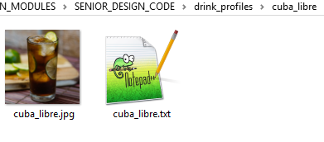
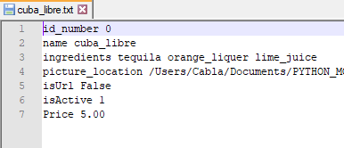
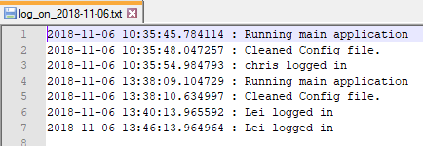
Task 4, Subtask 4.2: Develop efficient methods for information management
System and drink information is stored in text files in the local directory
Created an event logger for actions made by the user of the desktop application
Created a configuration file that customizes the application
Created a shared data directory that the HTTP server will share with the phone app

Slide 52
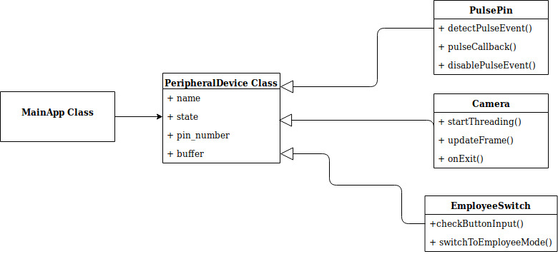
Task 4, Subtask 4.3: Add in capabilities for communication between the main computer & peripheral devices
The PeripheralDevice class defines a standard communication interface between peripheral devices and the main application
Individual devices will inherit functionality from the PeripheralDevice class

Slide 53
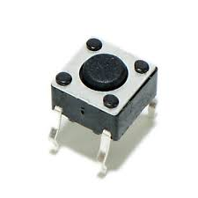
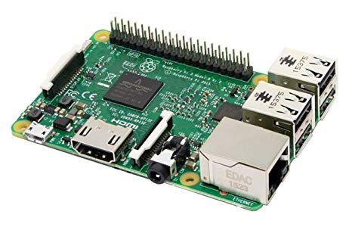
Task 4, Subtask 4.4: Create the interfaces between the main computer & peripheral devices
Employee Switch
Connected between a GPIO pin of the main computer (Raspberry Pi 3) and GND
When pressed, it sends the user directly to the login screen of employee mode
The state of the button is checked every 2 seconds by the application

Slide 54
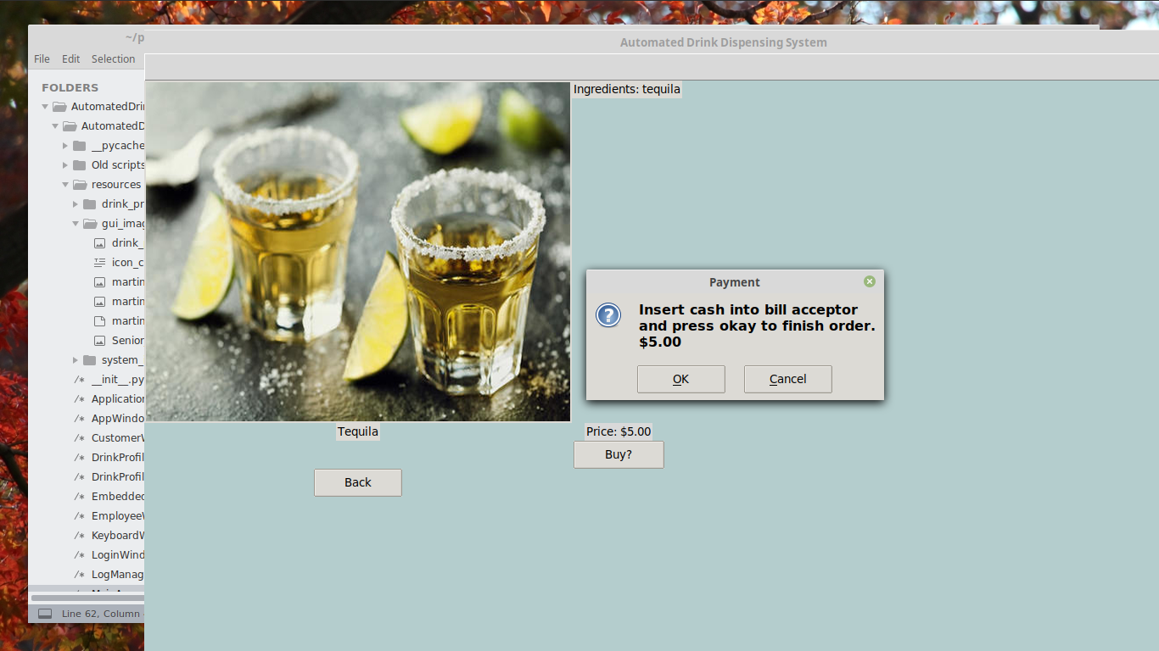
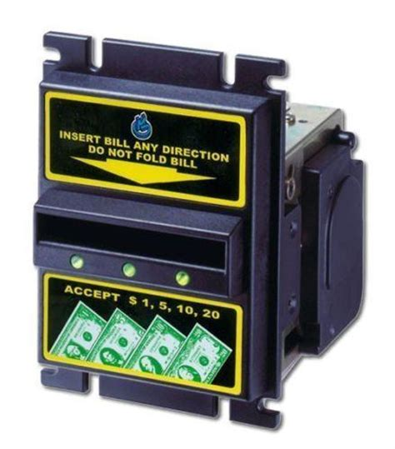
Task 4, Subtask 4.4: Create the interfaces between the main computer & peripheral devices
MEI Bill Acceptor
Commercial grade bill acceptor that accepts $1, $5, and $10 bills (rejects $20s)
Dip switches for configuration
Needs an input voltage of 115 VAC
Outputs pulses by connecting an open collector configuration to ground
1 pulse per $1
Required software debouncing to get accurate amount of pulses
Payment Confirmation

Slide 55


Task 4, Subtask 4.4: Create the interfaces between the main computer & peripheral devices
Bill Acceptor Schematic For Reading Pulses

Slide 56


Task 4, Subtask 4.4: Create the interfaces between the main computer & peripheral devices
Picamera
Frames of a video feed are captured and displayed within the GUI
On display until wait time is over
Frames will be processed by an intermediate function in order to add entertaining features
Made a CAD model and 3D printed it to hold picamera for testing

Slide 57



Task 5, Subtask 5.1: Design the UI of the phone app
Created a phone application via Android Studio
Phone application requires login credentials
Tabbed views once a successful login is achieved
App Icon
Login Page
Tabbed Views

Slide 58


Task 5, Subtask 5.2: Allow exchange of data between the phone app and main computer
Connects to the HTTP server hosted on the main computer
Loads inventory, sales, and system information into each their respective tabs
Allows for manual updating of shared data
Desktop app updates shared data every 3 minutes
Settings Options
URL Editor

Slide 59


Task 5, Subtask 5.3: Provide Monitoring Features in the App
The three tabbed views show:
Current inventory
Quantity left
Original quantity
Sales for specific days
A graph to show individual drink sales
System status information
A notification will be sent if the quantity left is half of the original quantity
Inventory Feature Tab
System Status Feature Tab

Slide 60

Task 6, Subtask 6.1: Incorporate facial recognition into the Desktop Application
Bunny Ears Feature Using Facial Recognition

Slide 61


Task 6, Subtask 6.1: Incorporate facial recognition into the Desktop Application
Bunny Ears Feature
Using OpenCV Python API to detect potential faces within each image frame
Employing Haar Cascade Classifier, which is a cascade of functions that detects features
With the list of potential faces in an image, a 2D animation is drawn within the plane of the frame
Requires a bit of geometry

Slide 62


Task 6, Subtask 6.1: Create the interfaces between the main computer & peripheral devices
Math for Bunny Ears Feature:

Slide 63



Task 6, Subtask 6.1: Incorporate facial recognition into the Desktop Application
Rainbow mask
Using a Haar Cascade for detecting faces
Performing a cross-dissolve like operation to draw a transparent, multicolored mask onto the face of an observer
P_{new} [i, j]= β*P₁[i, j] + ɑ*P₂[i, j]+ ɣ
Rainbow glasses filter
Using a Haar Cascade for detecting faces and eyes
Drawing 2D glasses animation with built-in drawing functions and geometry

Slide 64

Task 6, Subtask 6.1: Incorporate facial recognition into the Desktop Application
Rainbow mask and Glasses Filter in Full Demo

Slide 65

Task 6, Subtask 6.2: Adapt the desktop application for compliance with PYPI
Refactored code base to be compliant with Python Enhancement Proposals
Uploaded desktop application software to the Python Package Index (international software repository)
Allows for easier installation of desktop application software
Allows for a simpler updating process if new features are added
Supported for Python 3.5 & newer interpreters
Desktop app software package is specifically supported for the Raspbian Operating system (Debian based)
Excluding the peripheral device code, it will at least be able to run on Ubuntu variants (e.g. Lubuntu, Linux Mint)

Slide 66
Questions?

Slide 67
References
http://www.royalcaribbean.com/connect/robot-bartenders-shake-things-up-at-sea/
https://www.youtube.com/watch?v=fAh6hQRKBU8
https://intellipaat.com/tutorial/tutorial-mongodb-tutorial/mongodb-crud-operations/
https://docstore.mik.ua/orelly/perl3/tk/ch02_02.htm
https://en.wikipedia.org/wiki/Model%E2%80%93view%E2%80%93controller

